Slide 1
Early Warning System for Earthquakes
TRIPTI MALL

Slide 2
Problem Statement
Accurate earthquake prediction is crucial for disaster management and public safety due to:
Early Warning Systems: Providing vital time for evacuation and securing infrastructure.
Disaster Preparedness: Allowing efficient resource allocation and rescue planning.
Risk Mitigation: Identifying high-risk areas to reinforce structures and implement safety measures.
Public Awareness: Educating communities about safety protocols to reduce panic and casualties.
Economic Impact Reduction: Minimizing damage to buildings and infrastructure for quicker recovery.
Scientific Advancements: Contributing to research and understanding of seismic activity for better predictive models.

Slide 3
Data Sources:
Seismic records from USGS, obtained through Google Data Search and USGS.gov (utilizing web scraping techniques).

Slide 4
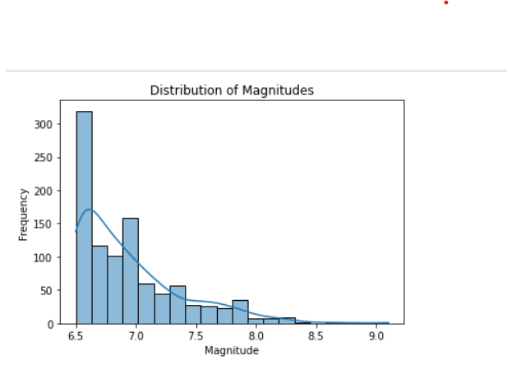
Data Visualizations via various charts
In the above chart the describes the relative proportion of earthquake magnitudes where it shows that frequency here are high and the magnitude increases linearly.
Also, the relationship between the magnitude and frequency of the earthquakes is reverse.

Slide 5
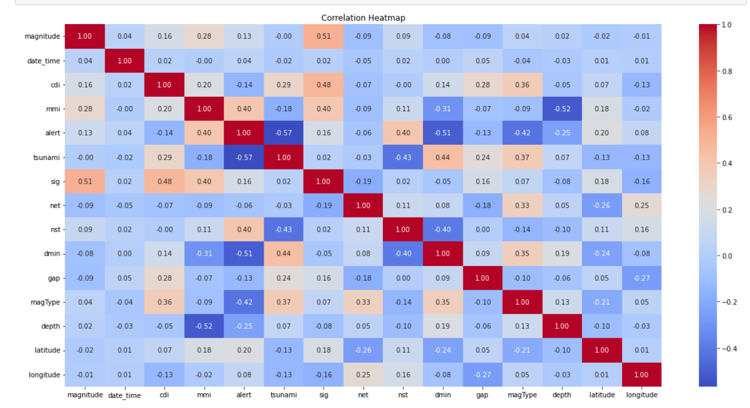
Correlation heatmap
Each cell is marked with a color ranging from -1 to +1. The closer this number is to -1, it means that two characteristics are inversely related to each other, and the closer this number is to +1, it means that two characteristics are directly related to each other.
It can be easily recognized from the Heatmap diagram:
Columns that are similar with same values but with different metadata (duplicate columns)

Slide 6
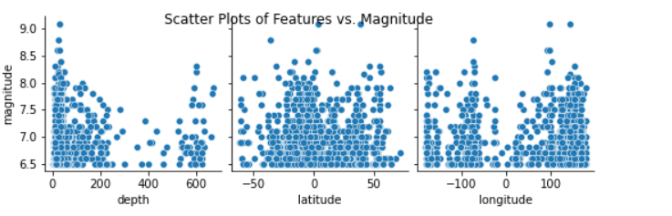
Scatter Plot to find the relationship
The Above Charts shows that the, depth is more when the magnitude is high
Similary, the relationship between earthquake magnitude and the geographic coordinates (latitude and longitude) of the earthquake epicenters.

Slide 7
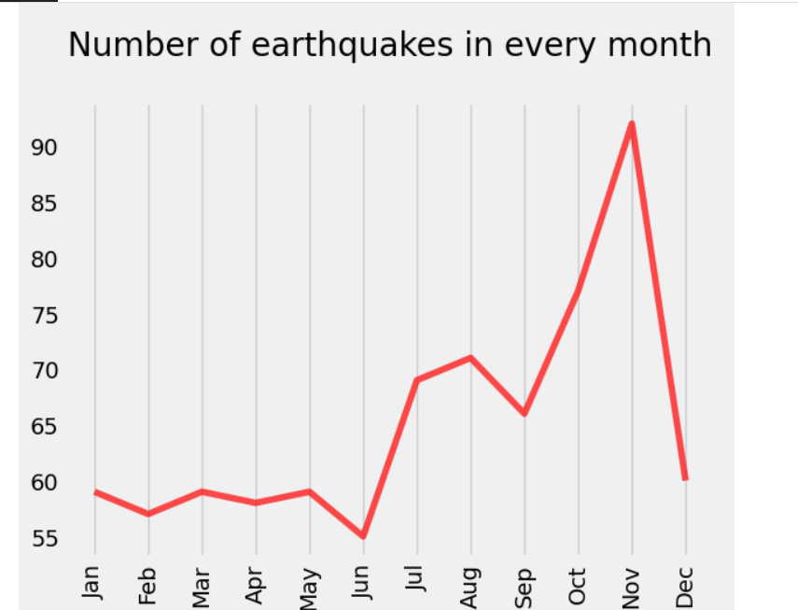
Number of earthquake in every month
In the Above, charts it represents that we have high number of earthquake in the month ranging from June to November

Slide 8
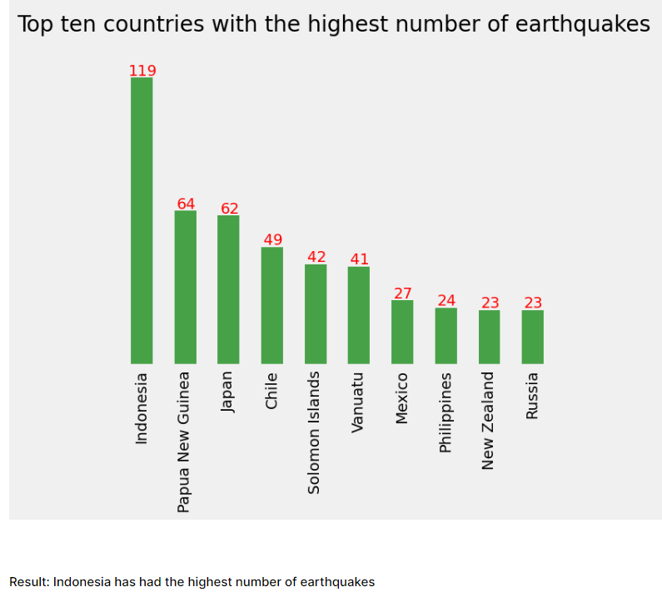
Top 10 countries with the highest number of earthquake
The above bar chart states that Indonesia has had the highest number of earthquake followed by Papua New Guinea and Japan

Slide 9
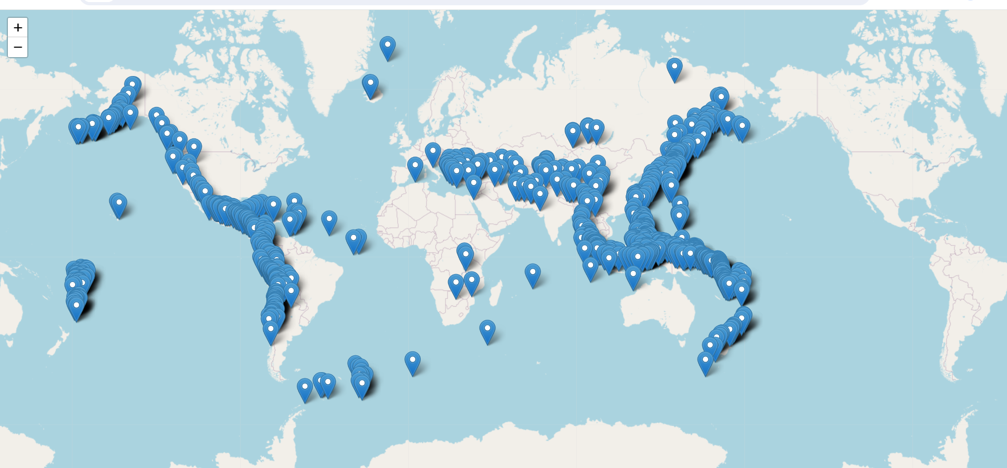
Effected country due to tsunami

Slide 10
Features used
magnitude: The magnitude of the earthquake
date_time: date and time
cdi: The maximum reported intensity for the event range
mmi: The maximum estimated instrumental intensity for the event
alert: The alert level - “green”, “yellow”, “orange”, and “red”
tsunami: "1" for events in oceanic regions and "0" otherwise
sig: A number describing how significant the event is. Larger the number, more significant the event. This value is determined on a number of factors, including: magnitude, maximum MMI, felt reports, and estimated impact
net: The ID of a data contributor. Identifies the network considered to be the preferred source of information for this event.
nst: The total number of seismic stations used to determine earthquake location.
dmin: Horizontal distance from the epicenter to the nearest station
gap: The largest azimuthal gap between azimuthally adjacent stations (in degrees). In general, the smaller this number, the more reliable is the calculated horizontal position of the earthquake. Earthquake locations in which the azimuthal gap exceeds 180 degrees typically have large location and depth uncertainties
magType: The method or algorithm used to calculate the preferred magnitude for the event
depth: The depth where the earthquake begins to rupture
latitude / longitude: coordinate system by means of which the position or location of any place on Earth's surface can be determined and described

Slide 11
Which Algorithms is Considered:
Logistic Regression: Simple and interpretable, suitable when interpretability is essential, but may not capture complex relationships effectively.
Support Vector Classifier (SVC): Effective in capturing complex relationships, robust against overfitting, suitable for nonlinear data like earthquake prediction.
Gaussian Naive Bayes: Efficient and simple, but assumes independence among features, may perform less accurately if this assumption doesn't hold.
Decision Tree Classifier: Captures complex relationships, highly interpretable, and showed high accuracy, making it a suitable choice for earthquake prediction.
KFold Cross-validation: Reliable method for estimating model performance, ensuring the models generalize well to new data.
Ensemble Technique: Combines multiple models for improved accuracy and reliability, beneficial for enhancing prediction performance in an early warning system.

Slide 12
Model Performance
Logistic Regression (83.4% accuracy):
Logistic Regression is a linear classification algorithm used for binary classification problems. It achieved an accuracy of 83.4%, indicating that it correctly predicted earthquake severity in 83.4% of cases.
Support Vector Classifier (SVC) (85.61% accuracy):
SVC is a powerful supervised learning algorithm used for classification tasks. It achieved a higher accuracy of 85.61%, indicating better predictive performance compared to Logistic Regression.
Gaussian Naive Bayes (76.32% accuracy):
Gaussian Naive Bayes is a probabilistic classifier based on Bayes' theorem with an assumption of independence between features. It achieved an accuracy of 76.32%, which might be lower due to the nature of the dataset or assumptions made by the algorithm.
Decision Tree Classifier (91.81% accuracy):
Decision Tree Classifier is a non-linear model that performs well on certain datasets by splitting features based on their importance. It achieved a high accuracy of 91.81%, indicating it was very effective in predicting earthquake severity.
Cross-validation using KFold technique (87.42% accuracy):
KFold cross-validation is a technique for assessing model performance by splitting the dataset into K folds and iteratively training and testing the model. It provided an accuracy of 87.42% on average across different folds, suggesting good generalization.
Ensemble Technique (85.40% accuracy):
Ensemble techniques like Random Forest or Gradient Boosting combine multiple models to improve prediction accuracy. It achieved an accuracy of 85.40%, indicating its effectiveness in earthquake prediction but might be slightly lower compared to Decision Tree Classifier in this case.

Slide 13
Challenges and limitations
Challenges Faced during the Project:
Limited Data Availability: Difficulty in obtaining extensive and diverse earthquake data for training the model, potentially impacting its ability to generalize to all scenarios.
Class Imbalance: Unequal distribution of earthquake severity levels in the dataset, leading to challenges in accurately predicting rare high-magnitude earthquakes.
Limitations of the Model or Data:
Sensitivity to Features: The model's performance might be highly dependent on specific features, potentially leading to reduced accuracy when new or unforeseen features are introduced.
Assumptions in Modeling: Certain assumptions made by the model (e.g., Gaussian Naive Bayes) might not entirely represent the complexities of seismic activity, affecting prediction accuracy.

Slide 14
Conclusion
The evaluation of various machine learning models for earthquake severity prediction yielded promising results and insights.
Model Performance: The Decision Tree Classifier demonstrated the highest accuracy at 91.81%, showcasing its effectiveness in predicting earthquake severity.
Versatility and Robustness: Support Vector Classifier (SVC) achieved an accuracy of 85.61%, indicating its robustness in handling complex relationships within earthquake data.
Challenges and Opportunities: Challenges in data availability and class imbalance were identified, suggesting the need for more diverse and balanced datasets for improved model generalization.

Slide 15
Thank you

